Slide 1

OOSA&D
02 Keeping your Objects in the Know：the Observer Pattern

Slide 2
Agenda
A Case Analysis
Design Pattern: The Observer Pattern
An Application for example
An experiment in class
Practices of design pattern as homework
Dalian Neusoft University of Information © Copyright

Slide 3
Agenda
A Case Analysis
Design Pattern: The Observer Pattern
An Application for example
An experiment in class
Practices of design pattern as homework
Dalian Neusoft University of Information © Copyright

Slide 4
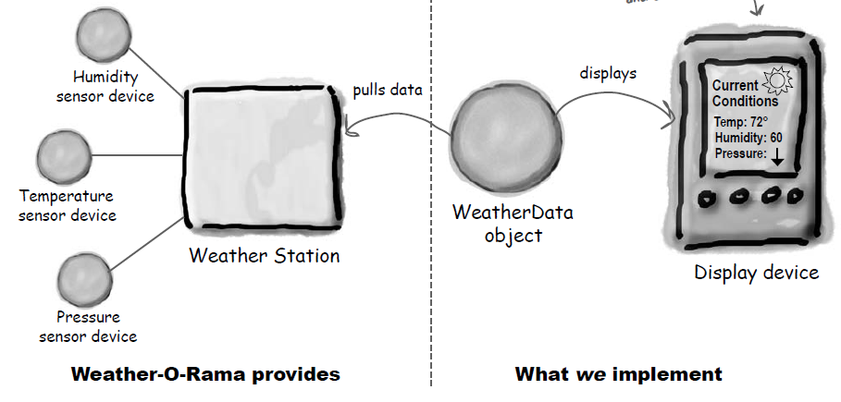
1. A Case Analysis
The Weather Monitoring Application
Dalian Neusoft University of Information © Copyright
Notes:
humidity 湿度

Slide 5
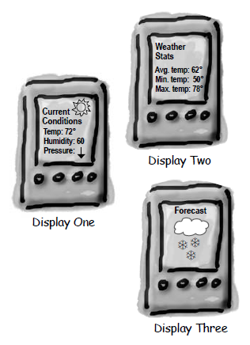
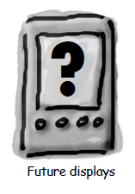
1. A Case Analysis
We need to implement three display elements that use the weather data.
The system must be expandable—other developers can create new custom display elements and users can add or remove as many display elements as they want to the application.
Dalian Neusoft University of Information © Copyright

Slide 6
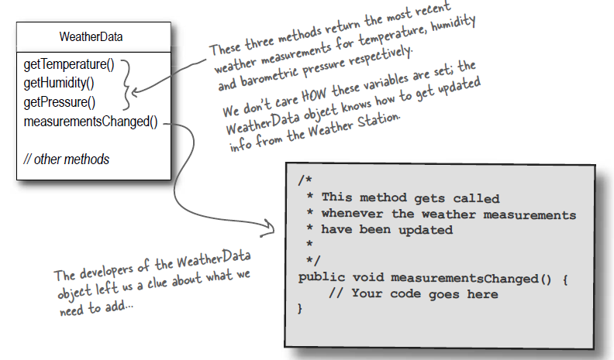
1. A Case Analysis
The WeatherData class
Dalian Neusoft University of Information © Copyright

Slide 7
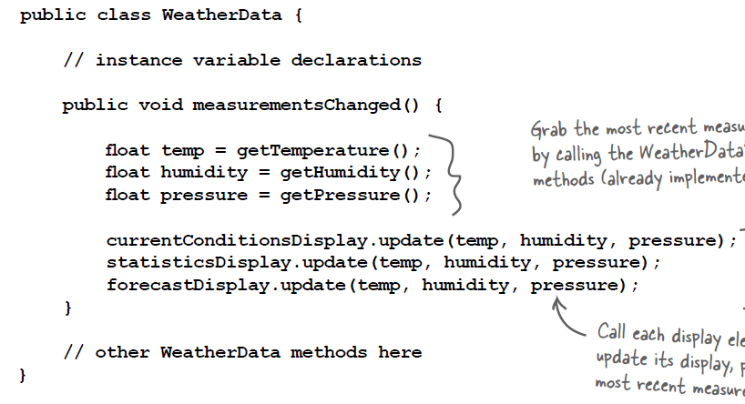
1. A Case Analysis
Here is the first implementation possibility.
Dalian Neusoft University of Information © Copyright

Slide 8
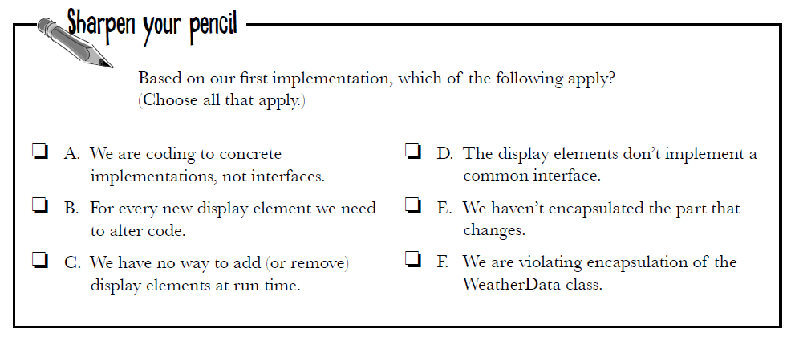
1. A Case Analysis
Here is the first implementation possibility.
Dalian Neusoft University of Information © Copyright

Slide 9
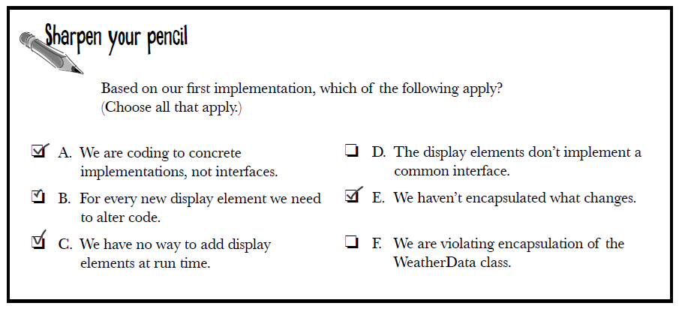
1. A Case Analysis
Here is the first implementation possibility.
Dalian Neusoft University of Information © Copyright

Slide 10
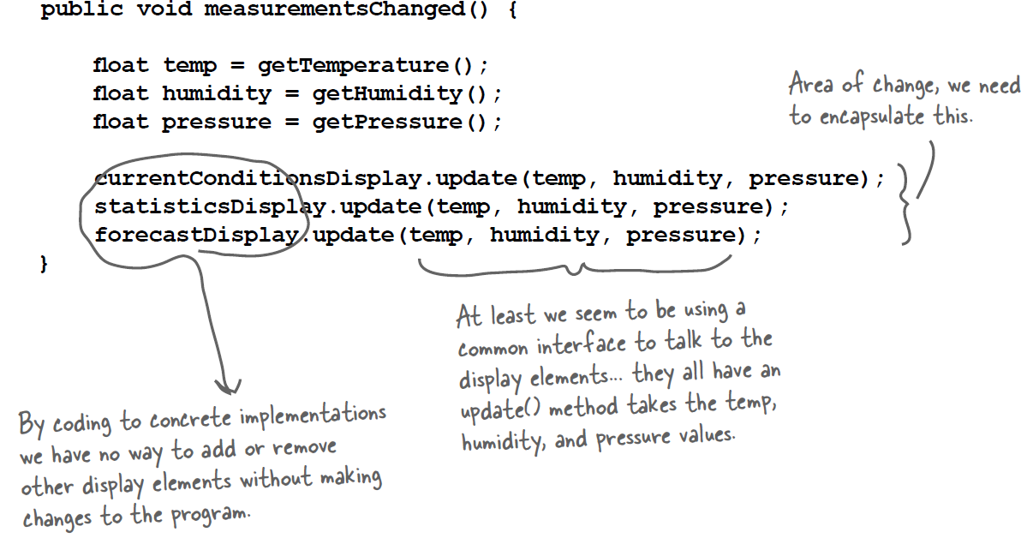
1. A Case Analysis
What’s wrong with the implementation?
Dalian Neusoft University of Information © Copyright

Slide 11
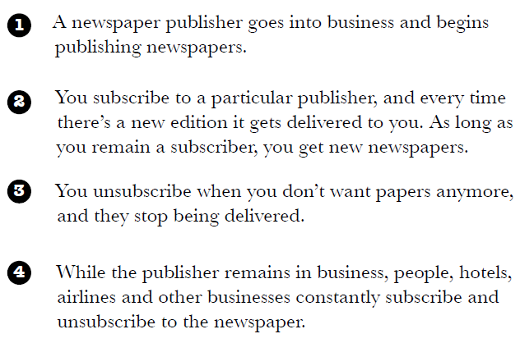
1. A Case Analysis
How newspaper subscriptions work?
Dalian Neusoft University of Information © Copyright

Slide 12


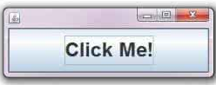

1. A Case Analysis
How newspaper subscriptions work?
to update if you require
WeatherData object
displays
to deliver if you subscribe
publishers
subscribers
to notify if you register
Button object
Listener objects
Dalian Neusoft University of Information © Copyright

Slide 13
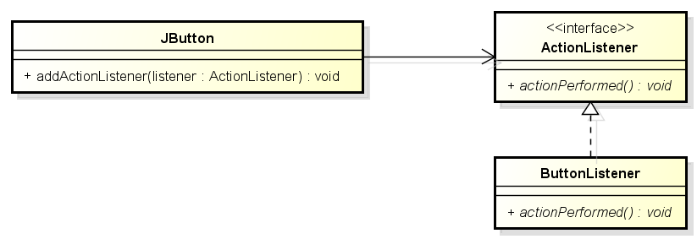
1. A Case Analysis
The Observer Pattern in the JDK
Dalian Neusoft University of Information © Copyright

Slide 14
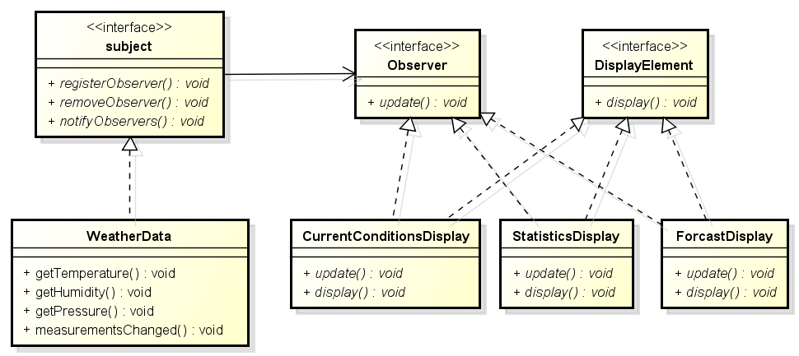
1. A Case Analysis
Designing the weather station
Dalian Neusoft University of Information © Copyright

Slide 15
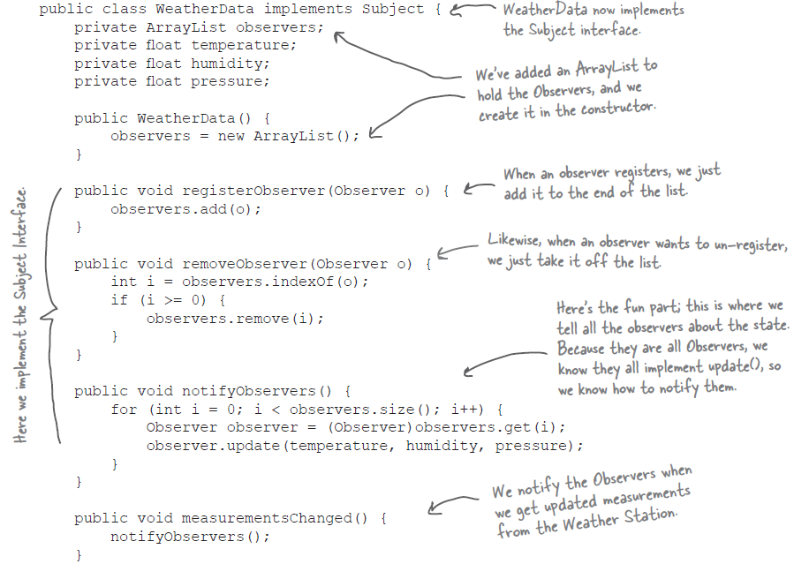
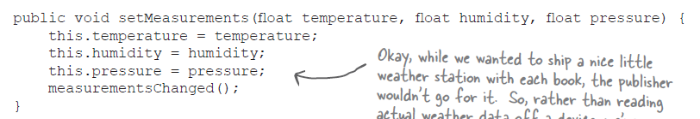

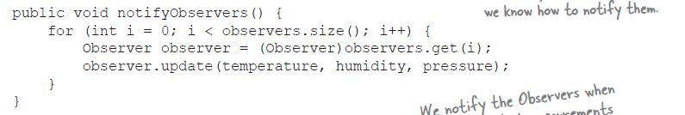
1. A Case Analysis
Designing the weather station
Dalian Neusoft University of Information © Copyright

Slide 16
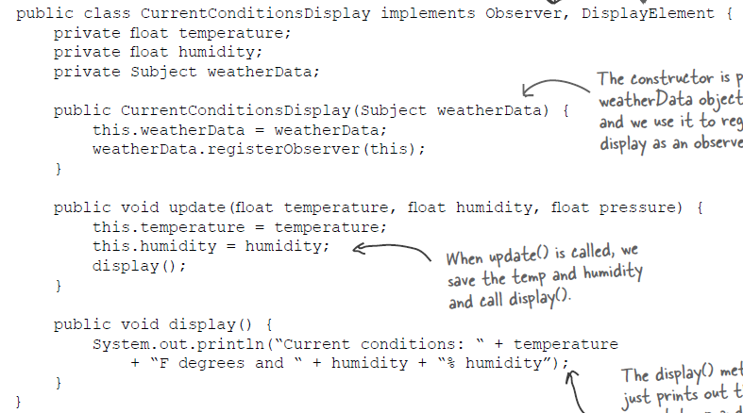
1. A Case Analysis
Designing the weather station
Dalian Neusoft University of Information © Copyright

Slide 17
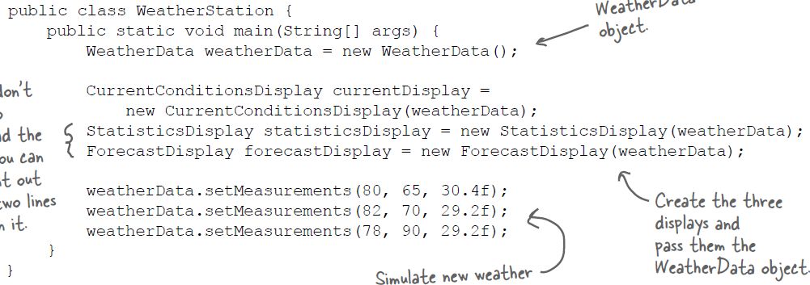
1. A Case Analysis
Testing the weather station
Dalian Neusoft University of Information © Copyright

Slide 18
Agenda
A Case Analysis
Design Pattern: The Observer Pattern
An Application for example
An experiment in class
Practices of design pattern as homework
Dalian Neusoft University of Information © Copyright

Slide 19
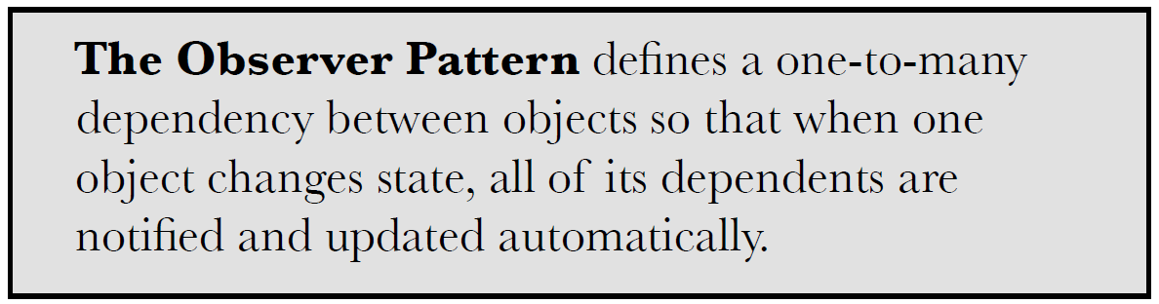

2. Design Pattern
Dalian Neusoft University of Information © Copyright

Slide 20
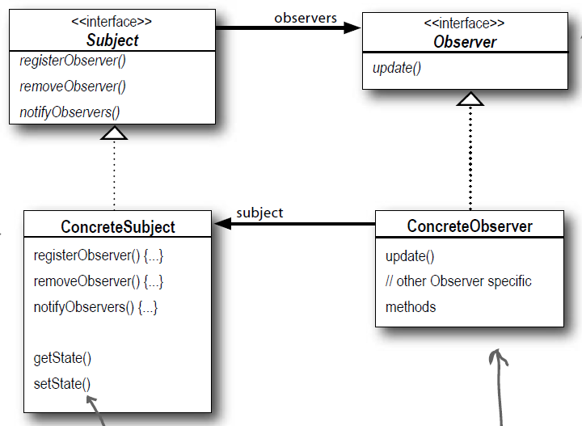
2. Design Pattern
Dalian Neusoft University of Information © Copyright

Slide 21
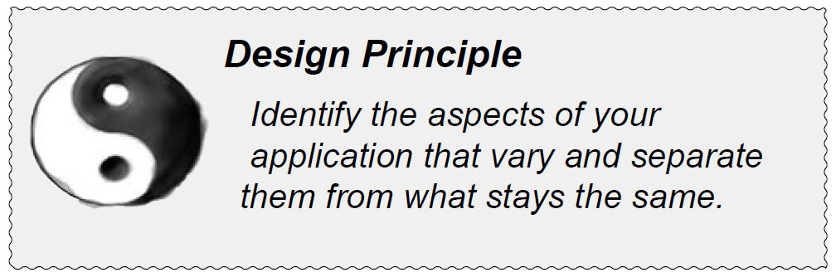
2. Design Pattern
Dalian Neusoft University of Information © Copyright

Slide 22
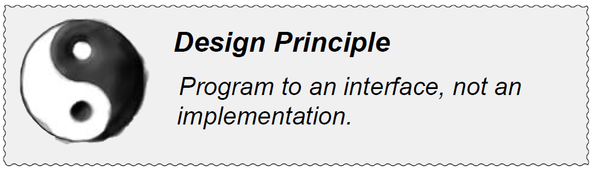
2. Design Pattern
Dalian Neusoft University of Information © Copyright

Slide 23
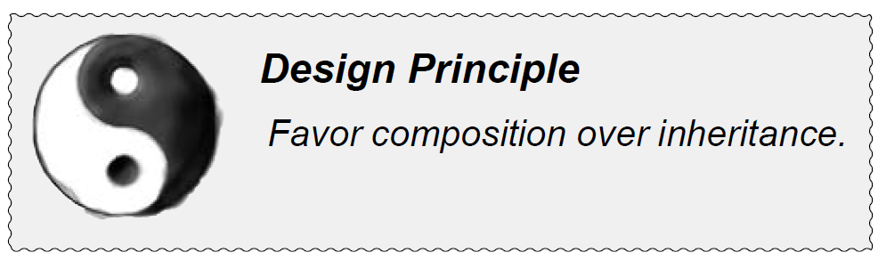
2. Design Pattern
Dalian Neusoft University of Information © Copyright

Slide 24
Agenda
A Case Analysis
Design Pattern: The Observer Pattern
An Application for example
An experiment in class
Practices of design pattern as homework
Dalian Neusoft University of Information © Copyright

Slide 25
3. An Application for example
A monitoring system : these jewelries can be protected by any beasts as appointment. If the jewelries is touched, these beasts will take action.
Jewelries: Gold, Diamond;
Beast: Lion, Tiger
In future, it is possible to has new jewelry and beast.
Your job is to…
Design the class diagram
program according to your class diagram
Test your design
Dalian Neusoft University of Information © Copyright

Slide 26
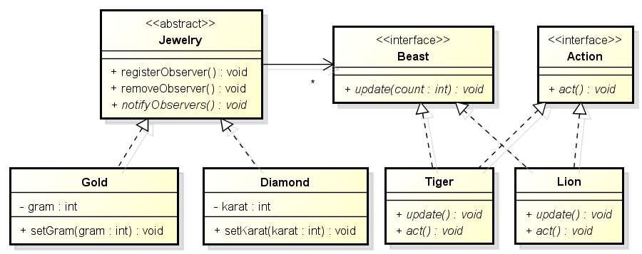
3. An Application for example
A monitoring system
Class Diagram

Slide 27
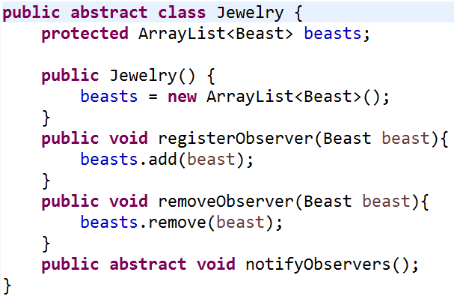
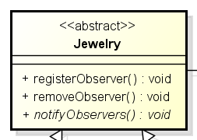
3. An Application for example

Slide 28
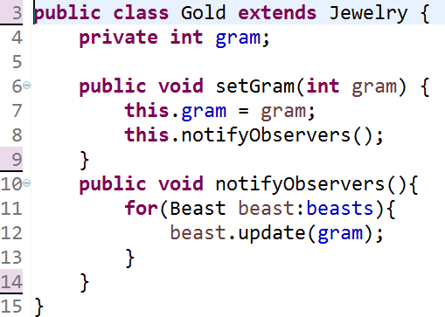
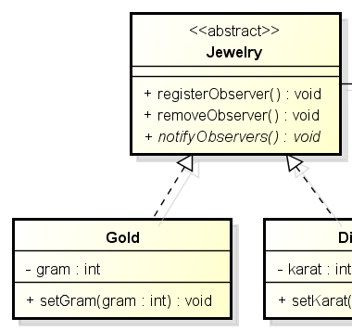
3. An Application for example

Slide 29
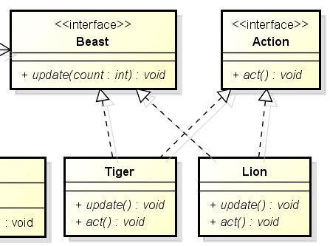
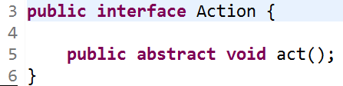
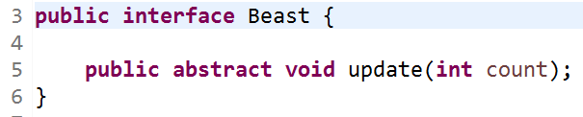
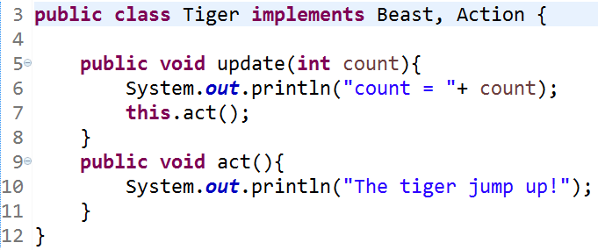
3. An Application for example

Slide 30
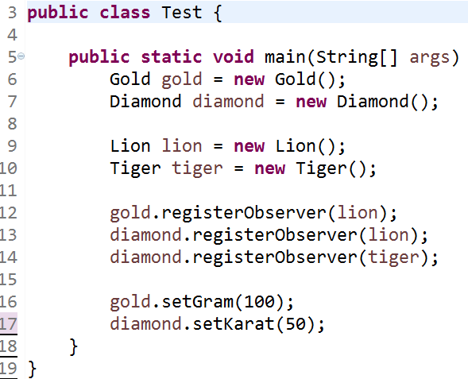
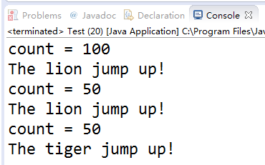
3. An Application for example
Console output:

Slide 31
How to Implement
Look over your business logic and try to break it down into two parts: the core functionality, independent from other code, will act as the publisher; the rest will turn into a set of subscriber classes.
Declare the subscriber interface. At a bare minimum, it should declare a single update method.
Declare the publisher interface and describe a pair of methods for adding a subscriber object to and removing it from the list. Remember that publishers must work with subscribers only via the subscriber interface.
Decide where to put the actual subscription list and the implementation of subscription methods. Usually, this code looks the same for all types of publishers, so the obvious place to put it is in an abstract class derived directly from the publisher interface. Concrete publishers extend that class, inheriting the subscription behavior.

Slide 32
How to Implement
However, if you’re applying the pattern to an existing class hierarchy, consider an approach based on composition: put the subscription logic into a separate object, and make all real publishers use it.
Create concrete publisher classes. Each time something important happens inside a publisher, it must notify all its subscribers.
Implement the update notification methods in concrete subscriber classes. Most subscribers would need some context data about the event. It can be passed as an argument of the notification method.
But there’s another option. Upon receiving a notification, the subscriber can fetch any data directly from the notification. In this case, the publisher must pass itself via the update method. The less flexible option is to link a publisher to the subscriber permanently via the constructor.
The client must create all necessary subscribers and register them with proper publishers.

Slide 33
Agenda
A Case Analysis
Design Pattern: The Observer Pattern
An Application for example
An experiment in class
Practices of design pattern as homework
Dalian Neusoft University of Information © Copyright

Slide 34

4. An experiment in class
An online stock system: When a stock price fluctuates more than 5%, the system automatically notified to all the shareholders.
Your job is to…
Design the class diagram
program according to your class diagram
Test your design with the old price is 100, the new price is 98 and 92.
Dalian Neusoft University of Information © Copyright

Slide 35
Agenda
A Case Analysis
Design Pattern: The Observer Pattern
An Application for example
An experiment in class
Practices of design pattern as homework
Dalian Neusoft University of Information © Copyright

Slide 36
5. Homework
Finish the homework, which includes 3 tasks.
Dalian Neusoft University of Information © Copyright

